Slide 1
Germination dissimilarity in alpine communities or Grubb’s theory to test: larger germination niche dissimilarity in alpine plant communities
Espinosa del Alba, C.¹, Götzenberger, L²., Fernández-Pascual, E.¹& Jiménez-Alfaro, B¹.

Slide 2
Main introductory points
High alpine diversity partly due to niche differentiation
Niche differentiation expected mainly due to harsh environment
Other studies focused on niche-based processes using traits/phylogeny
Regeneration traits hardly considered, only seed mass, BUT….

Slide 3
Main introductory points
Grubb’s theory says that:
Regeneration niche differentiation >> Adult plant niche differentiation
Plenty literature about diversity in regeneration trait but NO empirically based comparison between both sets of traits
Additionally, microclimatic conditions are known to be very important in alpine compositional and functional diversity of adult plants (existing literature) as well as for germination (almost no literature)

Slide 4
Main goal
Study germination niche dissimilarity pattern:
With community level metrics (CM/CWM and Functional divergence indices).
Empirical data for germination (3 traits) and adult plant traits (5 traits).
Detailed field measured microclimatic gradients in two communities.
To our knowledge no one has tested it empirically

Slide 5
Objectives
Determine germination patterns to main drivers in alpine communities
Explore relationships between CM/CWM and microclimatic gradients
Explore functional divergence (FD) in alpine communities
3.1. Compare germination and adult plant niche dissimilarities
3.2. Relationships between FD and microclimatic gradients
Need of clear hypothesis to understand results and be able to compare it with literature.

Slide 6
Data availability
8 functional traits:
3 germination responses to darkness, water stress and constant temperatures
5 adult traits extensively used:
Leaf area, plant height and seed mass (LHS scheme)
SLA and LDMC
Species with full set of traits:
18 species in Mediterranean community (5 sp with no germination, 1 with no leaves traits)
25 species in Temperate community (7 sp with no germination, 2 with no leaves traits)

Slide 7
Environmental data availability
4 sites per community, 20 plots per site (N real= 75 and 78 )
I will present preliminary results based on the most restrictive set of data.
CWM is most used in literature for FD and community metrics
 | MEDITERRANEAN | TEMPERATE
Abundance data (>80% cover of the plot with species traits and at least 2 species) | 48 | 47
Presence/absence data (>50% of species with traits and at least 2 species) | 70 | 68

Slide 8
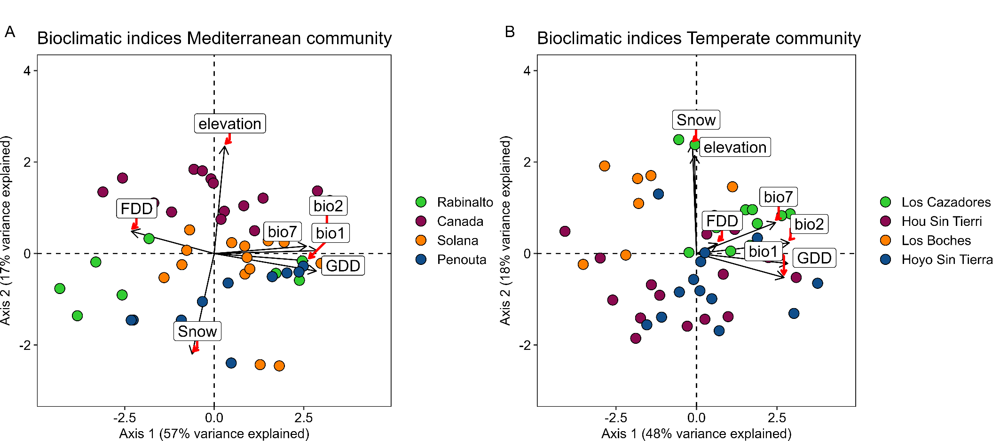
Data exploration: Environmental gradients (Calculated from different years)
 | Mediterranean | Temperate
Elevation | 2091 - 2157; x̄: 2120 | 1928 - 2138; x̄: 2020
FDD | 0 – 108; x̄: 23.2 | 0 – 194; x̄: 31.1
GDD | 959 – 2480; x̄: 1800 | 463 – 1382; x̄: 955
Snow days | 0 – 145; x̄: 32.5 | 0 – 234; x̄: 94.9

Slide 9
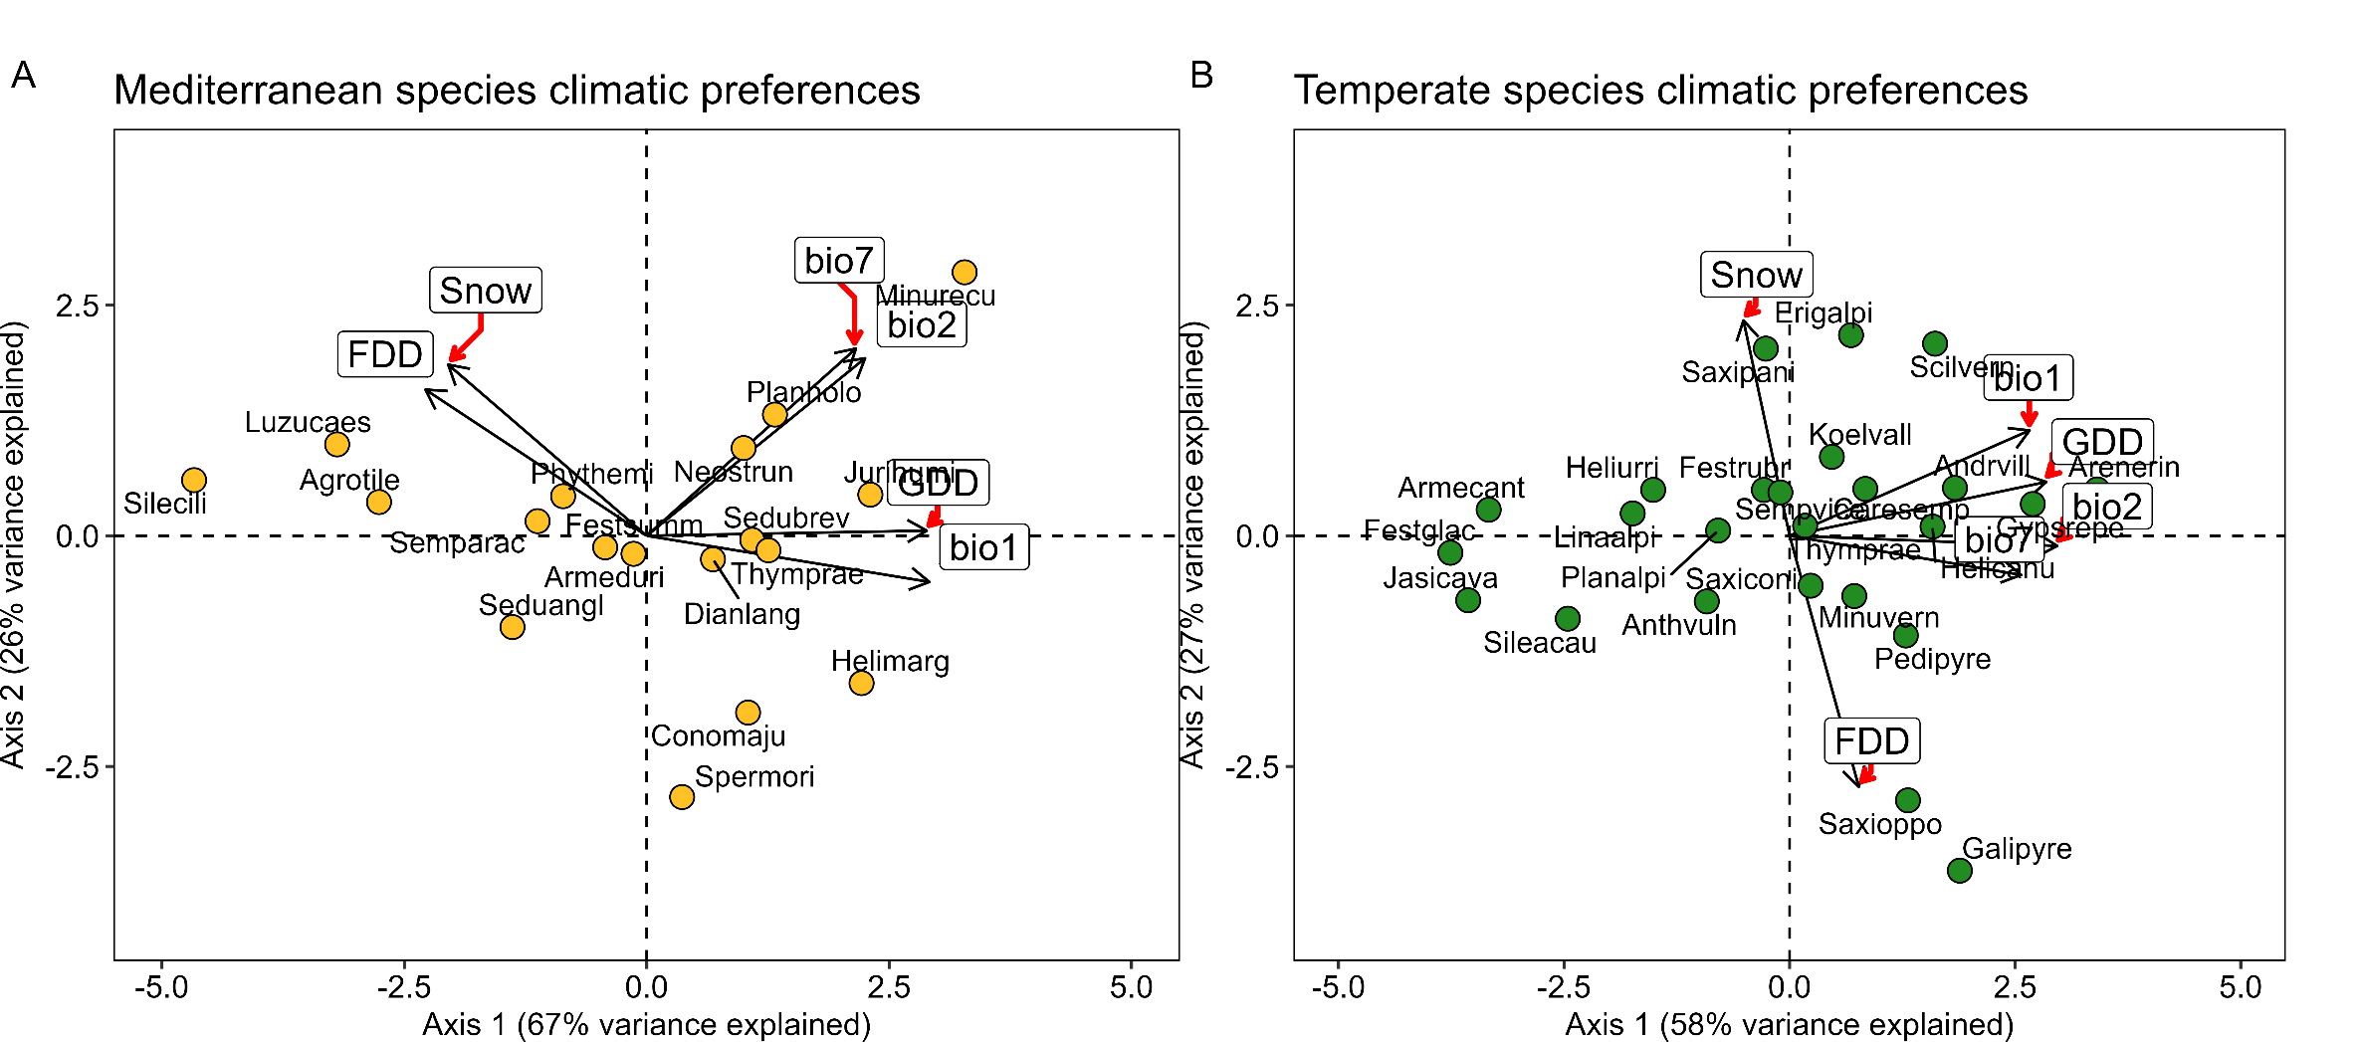
Data exploration: Species PCA climatic preferences

Slide 10
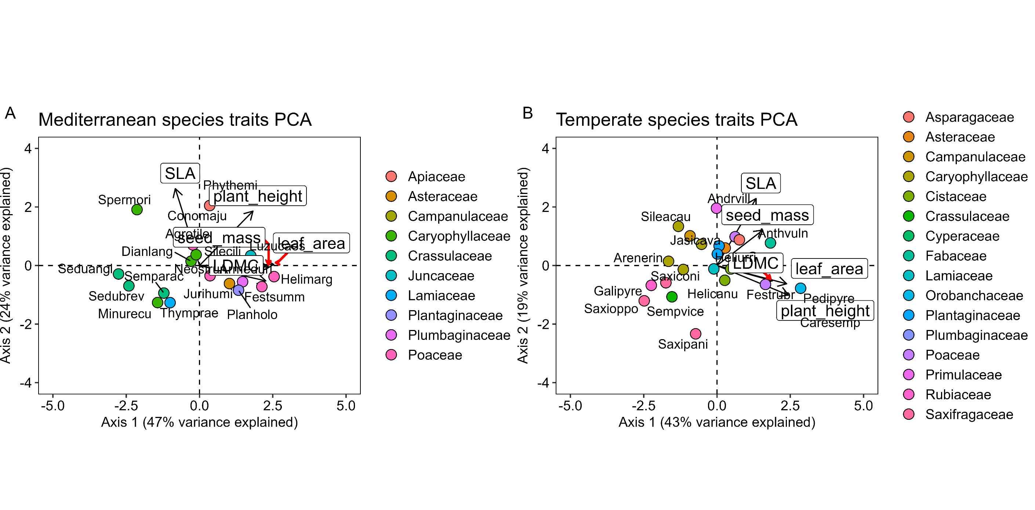
Data exploration: Adult plant traits PCA

Slide 11
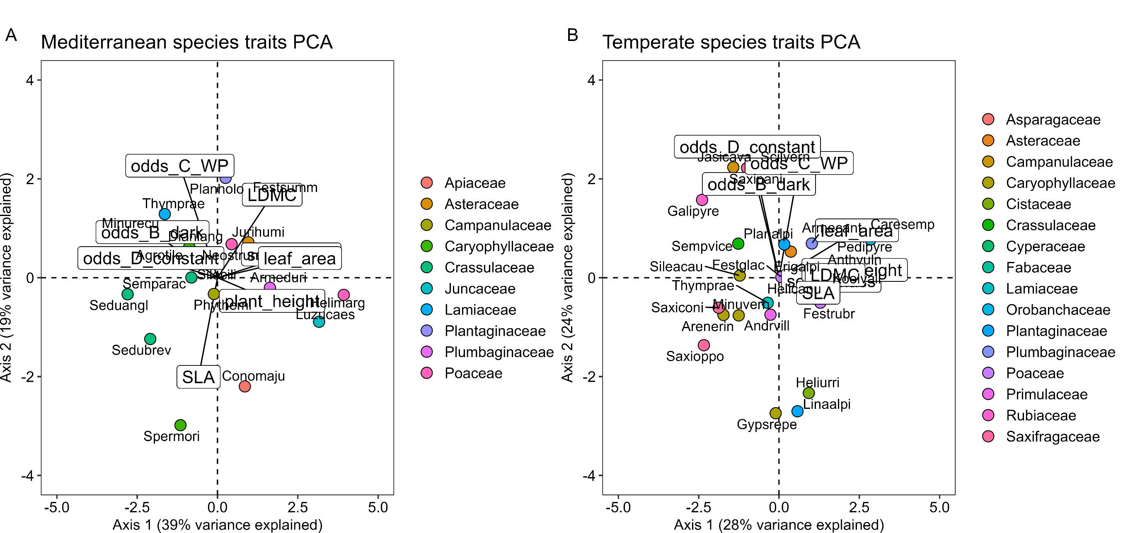
Data exploration: Traits PCA

Slide 12
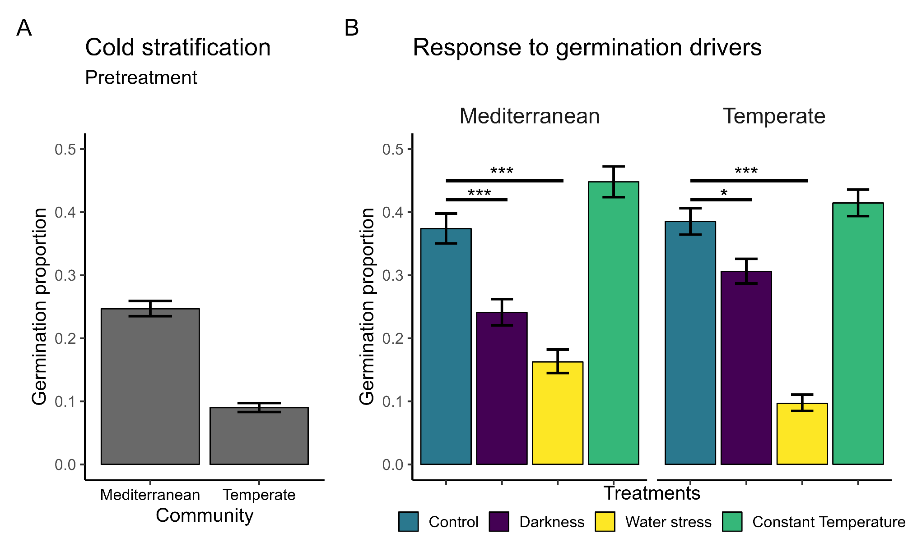
1. Germination patterns (Remove or keep in supplementary?)
MCMC-GLMMs
Consistent lower germination in darkness and water stress

Slide 13
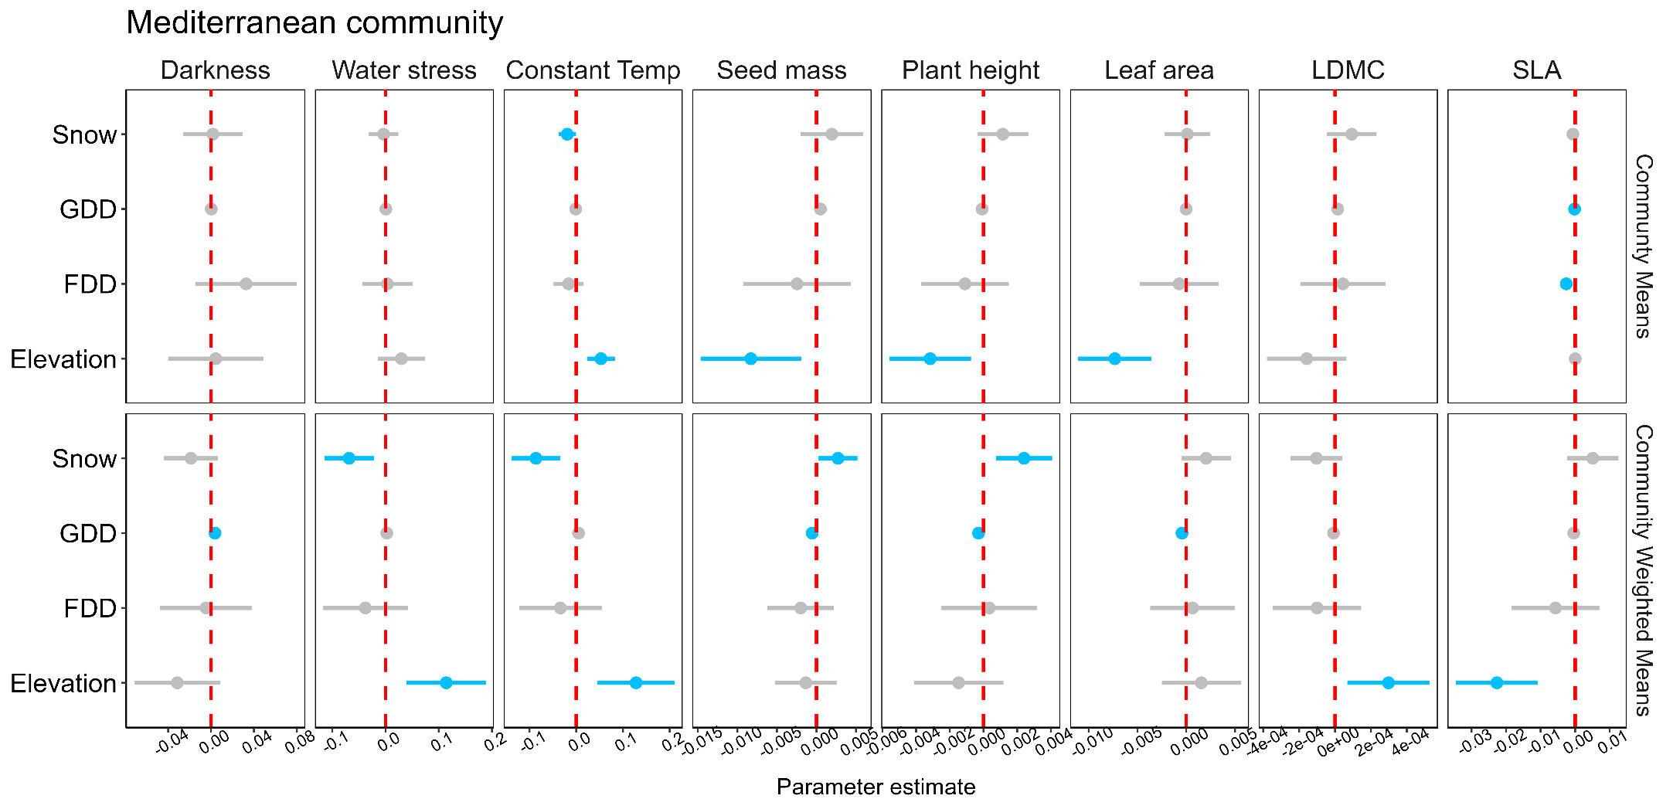
2. Community metrics along microclimatic gradients
LM estimate + CI
CM mostly responds to elevation
CWM mostly responds to snow, GDD and elevation
Consistent germination and plant traits responses mostly in opposite directions!!

Slide 14
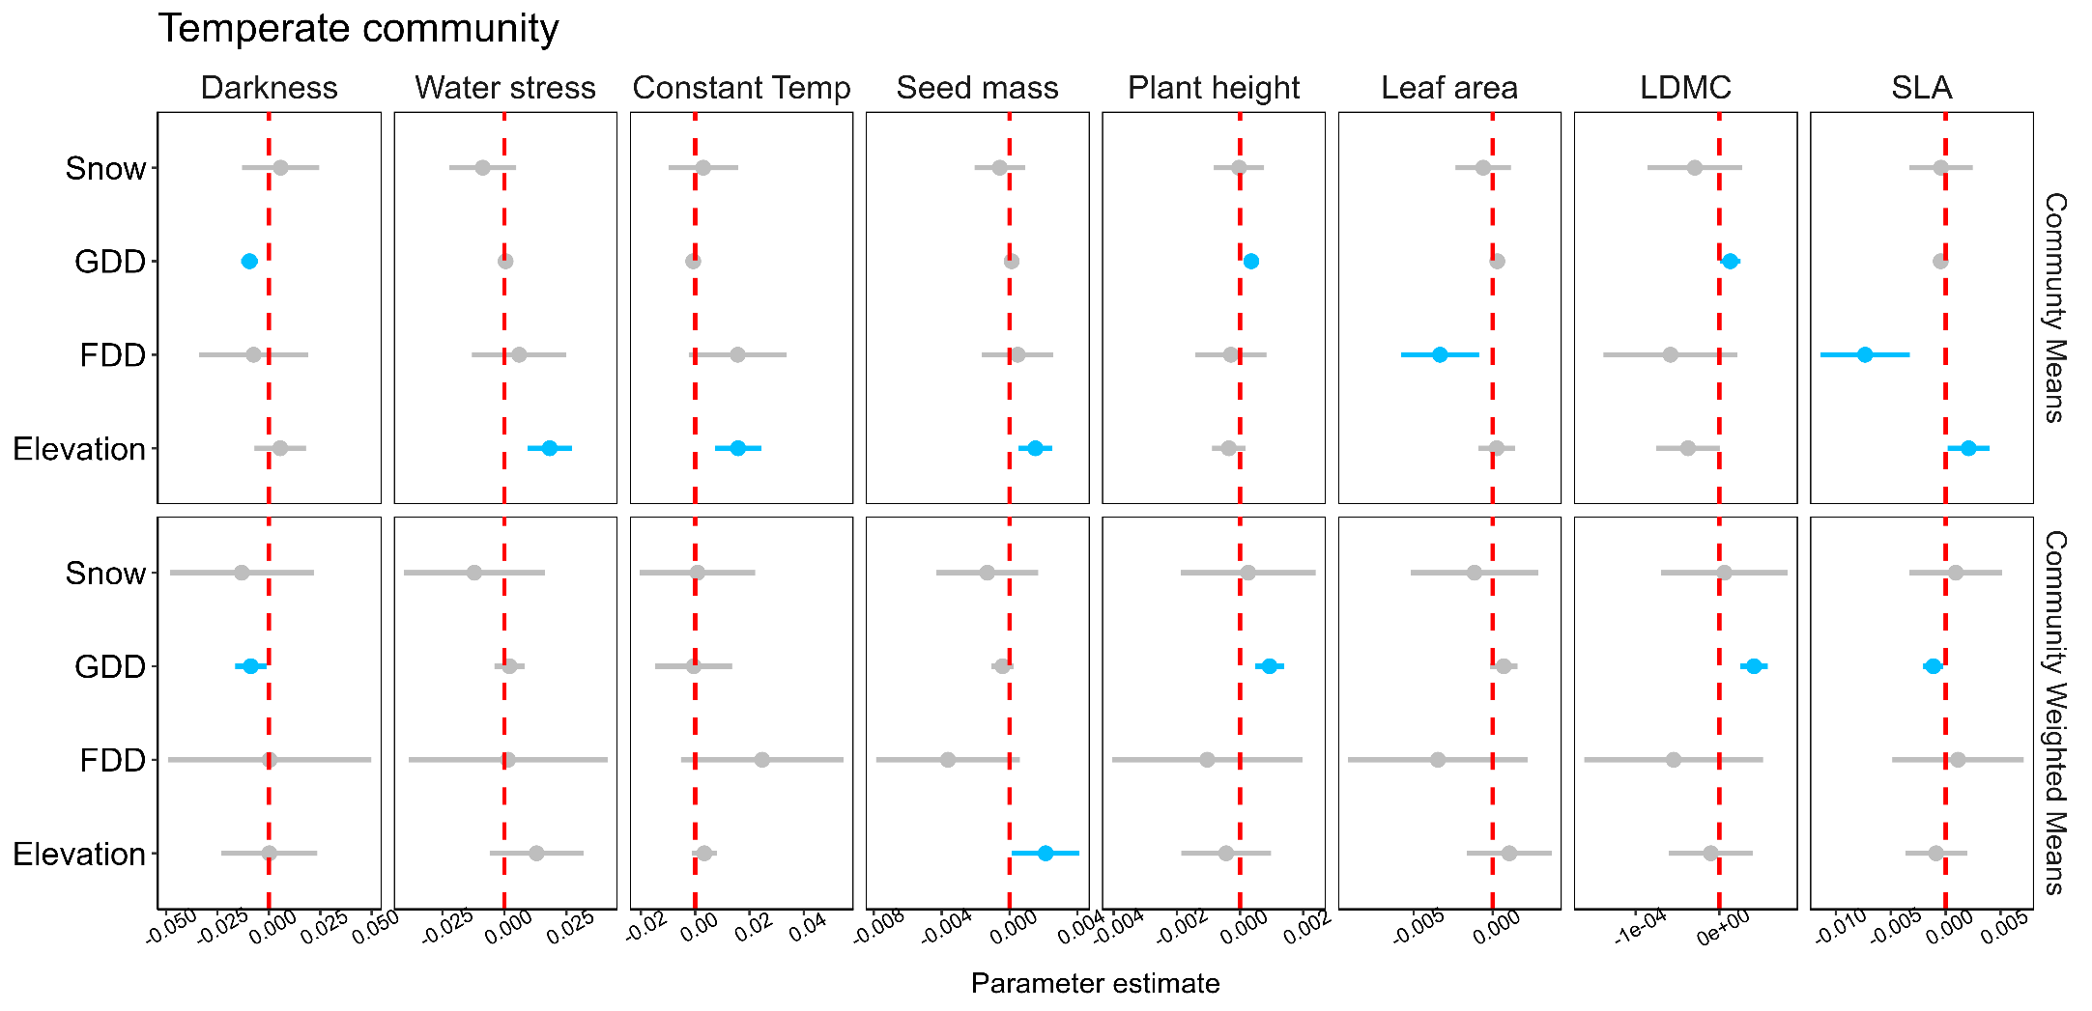
2. Community metrics along microclimatic gradients
LM estimate + CI
CM mostly responds to elevation, GDD and FDD
CWM mostly responds to GDD
Germination and plant traits responses mostly in opposite directions!!

Slide 15
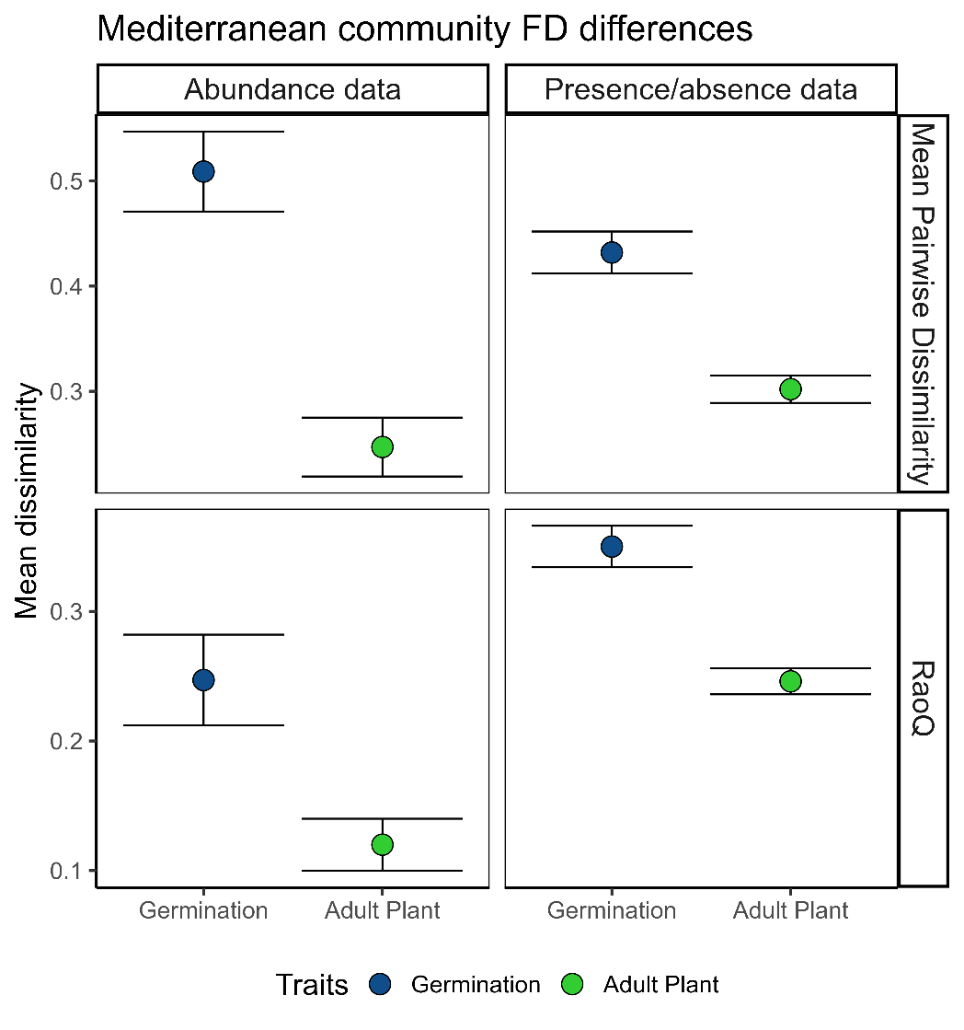
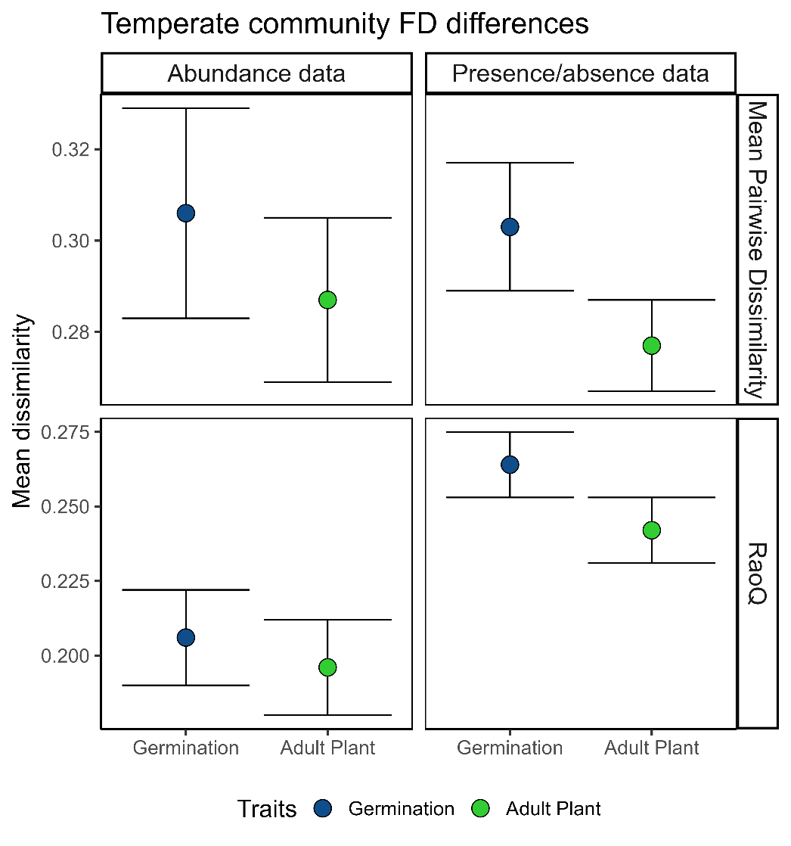
3.1 Germination and adult plant niche differentiation
Mean + CI (t-test)
Germination niche dissimilarity bigger than adult plant niche.
Both data types significant in mediterranean, only with presence/absence data in temperate.

Slide 16
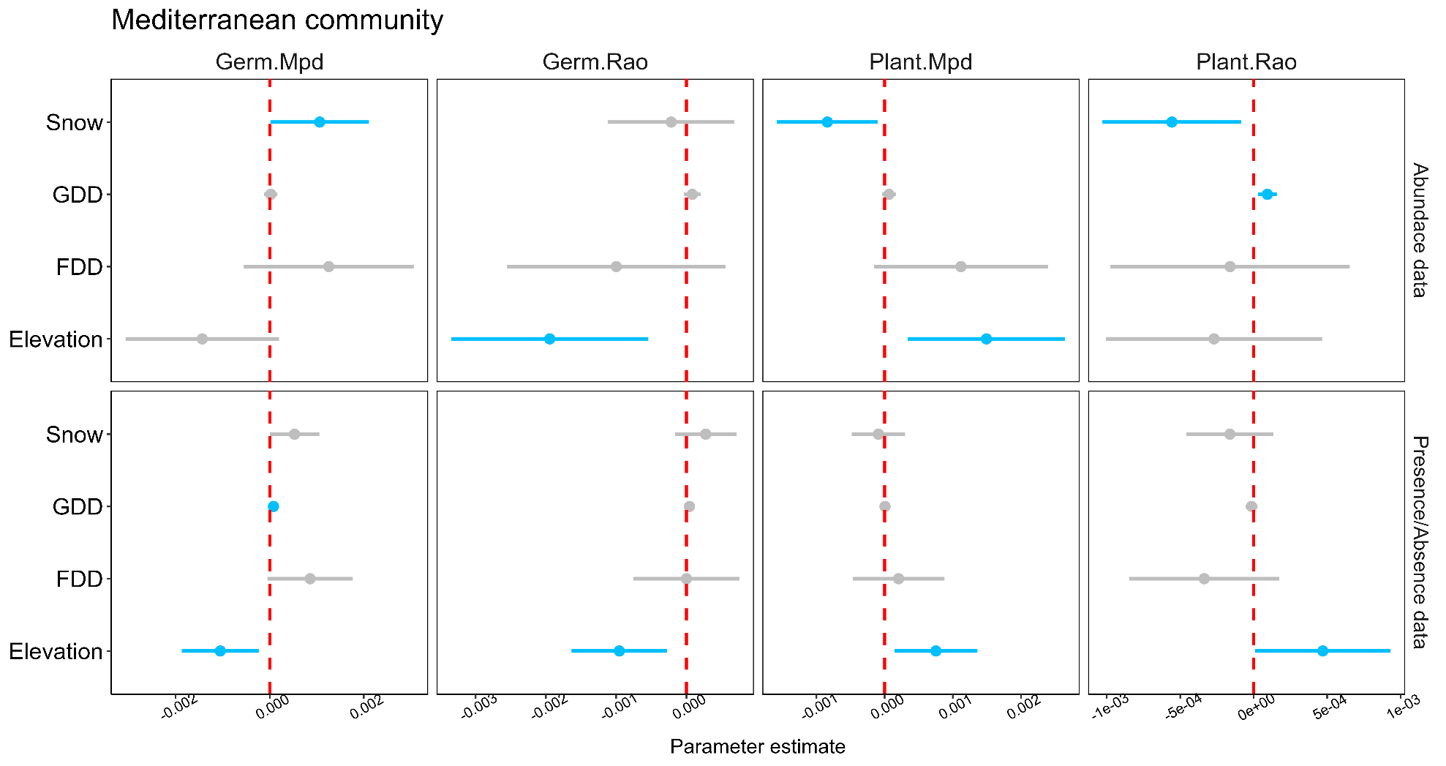
3.2 FD along microclimatic gradients
LM parameter + CI
Opposite trait differentiation trends between germination and adult plant niche.
Snow = germination divergent, plant convergent
Elevation = germination convergent, plant divergent

Slide 17
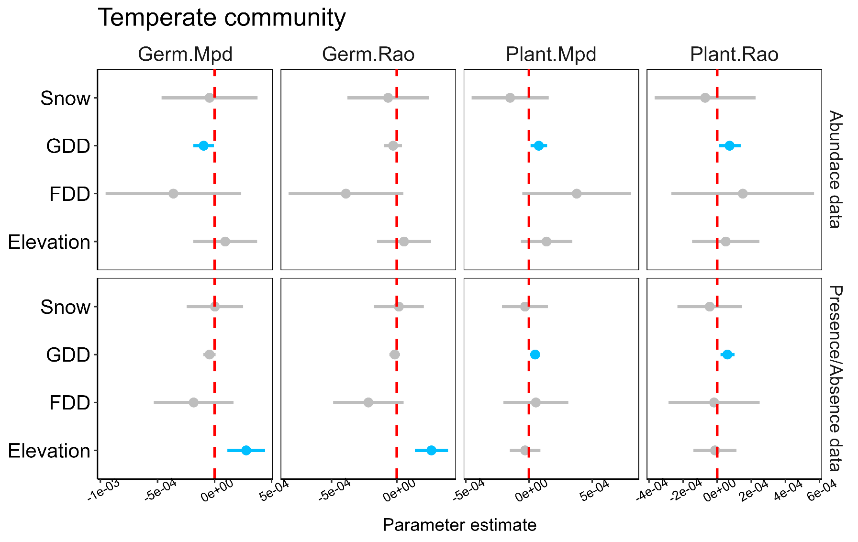
3.2 FD along microclimatic gradients
LM parameter + CI
Opposite trait differentiation trends between germination and adult plant niche.
GDD = germination convergent, plant divergent
Elevation = germination divergent

Slide 18
Answers to Objectives
Determine germination patterns to main drivers in alpine communities
Significantly worse germination in darkness and water stress
Trend of higher germination in constant temperatures (probably because lower limit of alternating temperatures slowed germination speed or is below germination threshold).

Slide 19
Answers to Objectives
2. Explore relationships between CM/CWM and microclimatic gradients
Different responses in each community probably due to distinct environmental limitations (some even opposite).
Different responses depending on CM or CWM
CM mostly respond to elevation (with only 100-200 m range)
CWM to snow and GDD in mediterranean, only GDD in temperate
Opposite germination and adult plant relationships with environment (always in mediterranean, mostly in temperate)

Slide 20
Answers to Objectives
3.1. Compare germination and adult plant niche dissimilarities
Germination niche dissimilarity bigger than adult plant niche (corroborating Grubb’s hypothesis)
Both data types significant in mediterranean, only with presence/absence data in temperate.

Slide 21
Answers to Objectives
3.2. Relationships between FD and microclimatic gradients
Opposite trait differentiation trends between germination and adult plant niche.
Snow = germination divergent, plant convergent (Mediterranean)
Elevation = germination convergent, plant divergent (Mediterranean)
GDD = germination convergent, plant divergent (Temperate)

